Slide 1
Technical Test : Data Analyst
Lazuardy Ilham Effendie
This technical test evaluates a candidate's ability to analyze user behavior using public datasets. It assesses their data analysis skills, including SQL querying, data visualization, and communication.

Slide 2
OUR PROCESS
Menyediakan insight untuk pengambilan keputusan
Menggunakan Looker
Menghapus dollar
Cleaning Data
query
Visualisasi
Input data
Export
Untuk inputnya menggunakan commands line
Mengambil Insight

Slide 3
Tujuan Analisis
Memahami perilaku nasabah berdasarkan demografi, kartu, dan transaksi
Mengetahui distribusi transaksi berdasarkan gender, kota, dan brand kartu
Mengukur penggunaan chip vs swipe
Menyediakan insight untuk pengambilan keputusan bisnis dan visualisasi Looker Studio

Slide 4
Dataset yang Digunakan
Saya menggunakan aplikasi HeidiSQL berikut untuk tablenya
Table
Isi Kolom
cards | Data kartu: id, client_id, brand, type, nomor, expires, cvv, chip, jumlah kartu diterbitkan, limit kredit, tahun PIN terakhir, card_on_dark_web
user_data | Data nasabah: id, umur, retirement_age, birth_year, birth_month, gender, address, latitude, longitude, per_capita_income, yearly_income, total_debt, credit_score, jumlah kartu
transaksi | Data transaksi: id_transaksi, client_id, card_id, amount, use_chip, merchant_id, merchant_city, merchant_state, zip, mcc, errors, amount_clean

Slide 5

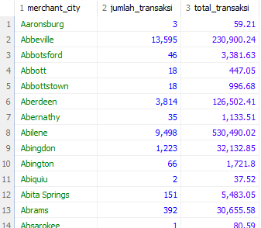


Total Transaksi & Rata-Rata per Gender
Penggunaan SQL untuk Eksplorasi
Transaksi per kota
Persentase transaksi pakai chip
Transaksi per level pendapatan

Slide 6
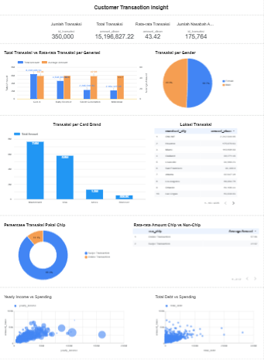
Visualisasi di Looker Studio
06
Menggunakan 350 Ribu data Dashboard ini akan menjawab: Siapa yang belanja? (Gender, Generasi, Kartu), Di mana belanja? (Kota/Map), Bagaimana cara belanja? (Chip vs Non-Chip), Apa hubungannya dengan profil keuangan? (Income, Debt, Credit Score).
Click Here !

Slide 7
THANKS!
Lazuardy Ilham effendie
081361954363
lazuardyilham07@gmail.com

Slide 8
DIGITAL ECONOMY ICON PACK

Slide 9
ALTERNATIVE RESOURCES
Photos
Young japanese woman portrait
Easy and wireless technology payment
Easy and wireless technology payment 1
Easy and wireless technology payment 2
Close-up of a person's hand inserting fifty euro banknote in piggybank on desk
Vectors
E-wallet concept illustration
Manage money concept illustration

Slide 10
RESOURCES
Vectors
Icons
Flat device mock-up infographic
Online shopping landing page
Teamwork landing page
Growing up landing page design
Online banking landing page
Online shopping landing page 1
Revenue Semi Flat Illustrations
Savings Semi Flat Illustrations
Digital Economy Icon Pack
Photos
Easy and wireless technology payment
Young japanese man portrait with glasses
Medium shot smiley man talking on phone
Medium shot smiley woman portrait
Top view piggy bank with person holding a bitcoin

